Slide 1
Murach’s PHP and MySQL (4th Edition)
Chapter 18
How to use SQL to work with
a MySQL database

Slide 2
Objectives
Applied
Code and run SELECT statements that use any of the language elements presented in this chapter.
Code and run INSERT, UPDATE, or DELETE statements that add, update, or delete rows.
Knowledge
Describe the use of the SELECT and FROM clauses in a SELECT statement, including the use of column aliases.
Describe the use of the LIMIT clause in a SELECT statement.
Describe the use of the WHERE clause in a SELECT statement, including the use of comparison operators, logical operators, the IS NULL operator, and the LIKE operator.
Describe the use of the ORDER BY clause in a SELECT statement.

Slide 3
Objectives (continued)
Describe the use of an inner join, including one that uses table aliases.
Describe the use of aggregate functions in SELECT statements.
Describe the use of the GROUP BY and HAVING clauses in a SELECT statement, and distinguish between HAVING clauses and WHERE clauses.
Describe the way subqueries can be used in the WHERE, HAVING, FROM and SELECT clauses of a SELECT statement.
Describe the use of INSERT, UPDATE, and DELETE statements, including the handling of NULL values and default values when coding INSERT and UPDATE statements.

Slide 4
The simplified syntax of the SELECT statement
SELECT select_list
FROM table_source
[WHERE search_condition]
[ORDER BY order_by_list]

Slide 5
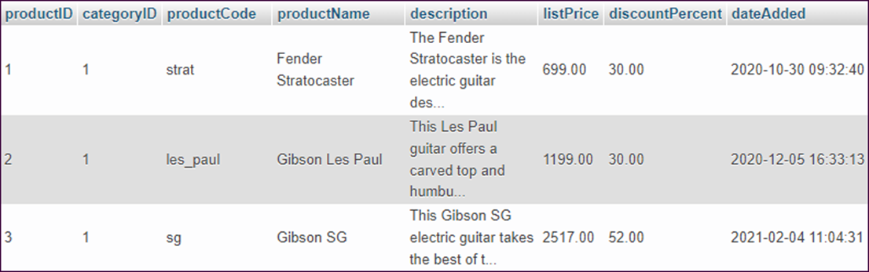
Retrieve all rows and columns from a table
SELECT * FROM products
The result set (3 rows of 10)

Slide 6
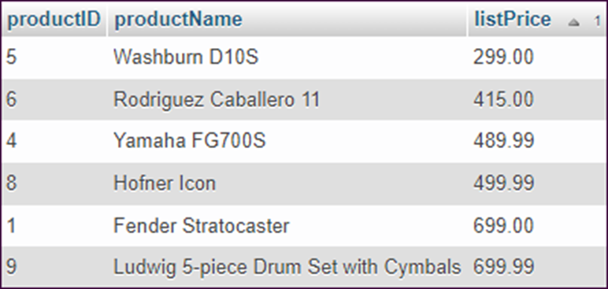
Retrieve three columns and sort them by price
SELECT productID, productName, listPrice
FROM products
ORDER BY listPrice
The result set (6 rows of 10)

Slide 7
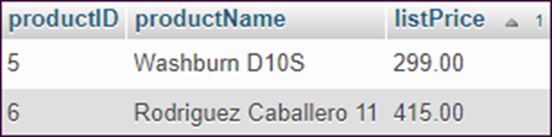
Retrieve rows in the specified price range
SELECT productID, productName, listPrice
FROM products
WHERE listPrice < 450
ORDER BY listPrice
The result set

Slide 8
Retrieve an empty result set
SELECT productID, productName, listPrice
FROM products
WHERE listPrice < 10

Slide 9
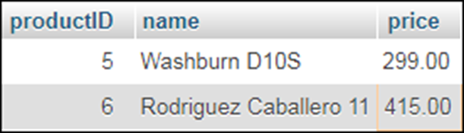
Use the AS keyword to specify an alias
SELECT productID, productName AS name, listPrice AS price
FROM products
WHERE listPrice < 450
ORDER BY listPrice
The result set

Slide 10
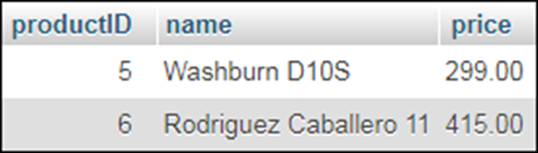
Omitting the AS keyword
SELECT productID, productName name, listPrice price
FROM products
WHERE listPrice < 450
ORDER BY listPrice
The result set

Slide 11
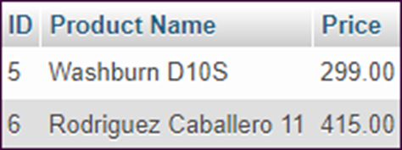
Use quotes to include spaces
SELECT productID AS 'ID', productName AS 'Product Name',
listPrice AS 'Price'
FROM products
WHERE listPrice < 450
ORDER BY listPrice
The result set

Slide 12
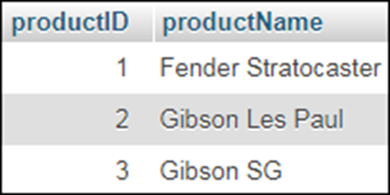
The syntax of the LIMIT clause
LIMIT [rowOffset, ] maxRows
Retrieve the first three rows of the result set
SELECT productID, productName
FROM products
LIMIT 3
The result set

Slide 13

Another way to retrieve the first three rows
SELECT productID, productName
FROM products
LIMIT 0, 3
The result set

Slide 14
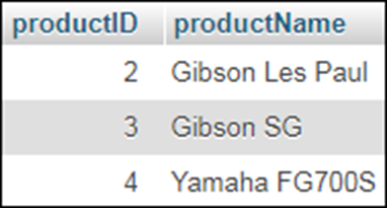
Retrieve three rows starting at the second row
SELECT productID, productName
FROM products
LIMIT 1, 3
The result set

Slide 15
The syntax of the WHERE clause with comparison operators
WHERE expression_1 operator expression_2
The comparison operators
=
>
<
<=
>=
<>

Slide 16
A WHERE clause that selects products where the product… (part 1)
Is in the specified category
WHERE categoryID = 2
Has the specified name
WHERE productName = 'Gibson Les Paul'
Has a list price less than the specified price
WHERE listPrice < 499.99
Has a list price greater than or equal to the specified price
WHERE listPrice >= 499.99
Has a name that starts with the letters A to F
WHERE productName < 'G'

Slide 17
A WHERE clause that selects products where the product… (part 2)
Was added before the specified date
WHERE dateAdded < '2021-01-31'
Was added on or after the specified date
WHERE dateAdded >= '2021-01-31'
Has a discount percent that does not equal
the specified amount
WHERE discountPercent <> 30

Slide 18
The syntax of the WHERE clause with logical operators
WHERE [NOT] search_condition_1
{AND|OR} [NOT] search_condition_2 ...
A search condition that uses the AND operator
WHERE categoryID = 1 AND discountPercent = 30
A search condition that uses the OR operator
WHERE categoryID = 1 OR discountPercent = 30
A search condition that uses the NOT operator
WHERE NOT listPrice >= 500
The same condition rephrased to eliminate NOT
WHERE listPrice < 500

Slide 19
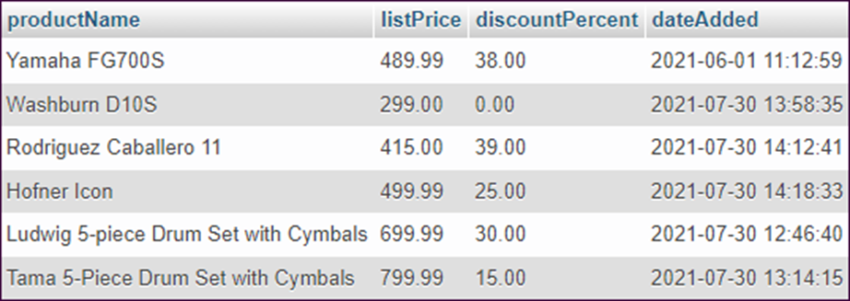
A compound condition without parentheses
SELECT productName, listPrice, discountPercent, dateAdded
FROM products
WHERE dateAdded > '2021-07-01' OR listPrice < 500
AND discountPercent > 25
The result set

Slide 20
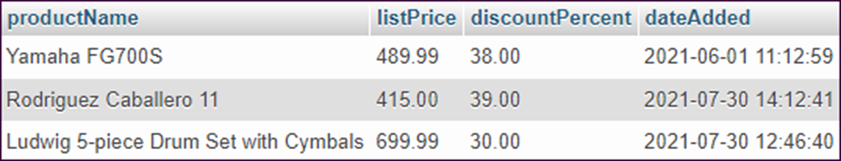
The same compound condition with parentheses
SELECT productName, listPrice, discountPercent, dateAdded
FROM products
WHERE (dateAdded > '2021-07-01' OR listPrice < 500)
AND discountPercent > 25
The result set

Slide 21
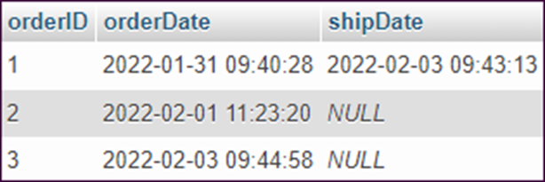
The syntax of the WHERE clause with the IS NULL operator
WHERE expression IS [NOT] NULL
Retrieve all rows
SELECT orderID, orderDate, shipDate
FROM orders
The result set

Slide 22
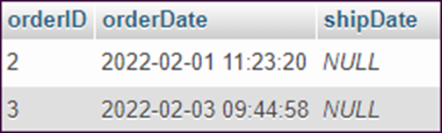
Retrieve rows for orders that haven’t been shipped
SELECT orderID, orderDate, shipDate
FROM orders
WHERE shipDate IS NULL
The result set

Slide 23
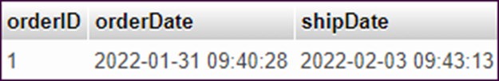
Retrieve rows for orders that have been shipped
SELECT orderID, orderDate, shipDate
FROM orders
WHERE shipDate IS NOT NULL
The result set

Slide 24
The syntax of the WHERE clause with the LIKE operator
WHERE match_expression [NOT] LIKE pattern
Wildcard symbols
Symbol | Description
% | Matches any string of zero or more characters.
_ | Matches any single character.

Slide 25
WHERE clauses that use the LIKE operator
WHERE productName LIKE 'Fender%'
WHERE productName LIKE '%cast%'
WHERE zipCode LIKE '076__'
WHERE orderDate LIKE '2022-01-__%'

Slide 26
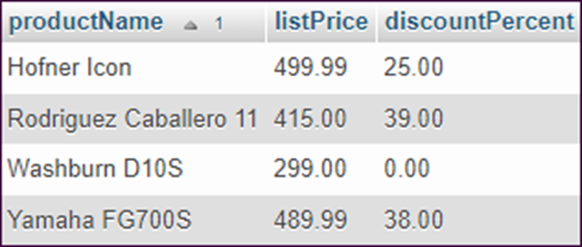
The syntax of the ORDER BY clause
ORDER BY expression [ASC|DESC]
[, expression [ASC|DESC]] ...
Sort by one column in ascending sequence
SELECT productName, listPrice, discountPercent
FROM products
WHERE listPrice < 500
ORDER BY productName
The result set

Slide 27
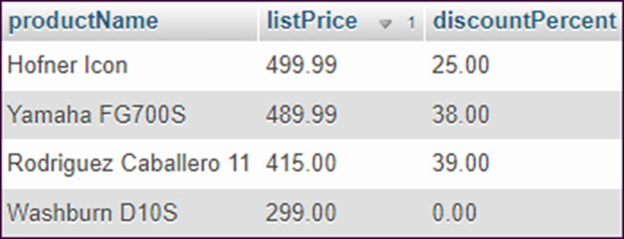
Sort by one column in descending sequence
SELECT productName, listPrice, discountPercent
FROM products
WHERE listPrice < 500
ORDER BY listPrice DESC
The result set

Slide 28
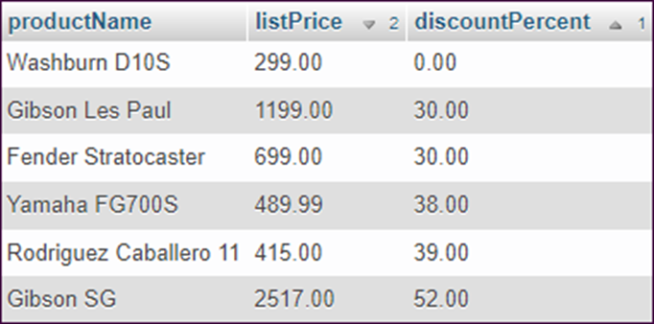
Sort by two columns
SELECT productName, listPrice, discountPercent
FROM products
WHERE categoryID = 1
ORDER BY discountPercent, listPrice DESC
The result set

Slide 29
The explicit syntax for an inner join
SELECT select_list
FROM table_1
[INNER] JOIN table_2
ON join_condition_1
[[INNER] JOIN table_3
ON join_condition_2]...

Slide 30
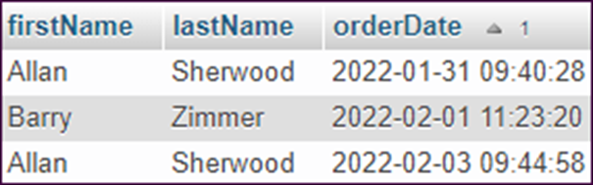
Joining the customers and orders tables
SELECT firstName, lastName, orderDate
FROM customers
INNER JOIN orders
ON customers.customerID = orders.customerID
ORDER BY orderDate
The result set

Slide 31
The syntax for an inner join that uses table aliases
SELECT select_list
FROM table_1 [AS] n1
[INNER] JOIN table_2 [AS] n2
ON n1.column_name operator n2.column_name
[[INNER] JOIN table_3 [AS] n3
ON n2.column_name operator n3.column_name]...

Slide 32
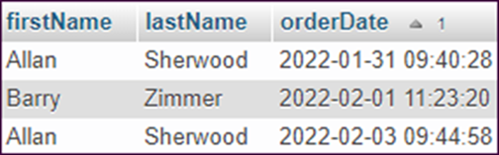
An inner join with aliases for all tables
SELECT firstName, lastName, orderDate
FROM customers c
INNER JOIN orders o
ON c.customerID = o.customerID
ORDER BY orderDate
The result set

Slide 33
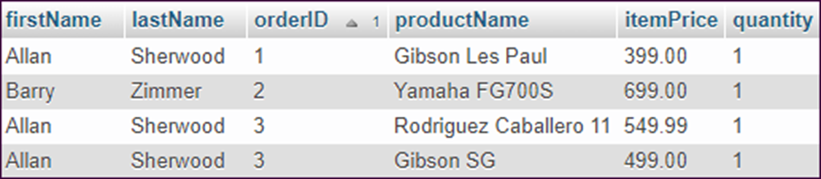
An inner join with aliases for four tables
SELECT firstName, lastName, o.orderID,
productName, itemPrice, quantity
FROM customers c
INNER JOIN orders o
ON c.customerID = o.customerID
INNER JOIN orderItems oi
ON o.orderID = oi.orderID
INNER JOIN products p
ON oi.productID = p.productID
ORDER BY o.orderID
The result set

Slide 34
The syntax of the aggregate functions
AVG(expression)
SUM(expression)
MIN(expression)
MAX(expression)
COUNT(expression)
COUNT(*)

Slide 35

Count all products
SELECT COUNT(*) AS productCount
FROM products
The result set

Slide 36

Count all orders and shipped orders
SELECT COUNT(*) AS totalCount,
COUNT(shipDate) AS shippedCount
FROM orders
The result set

Slide 37

Find lowest, highest, and average prices
SELECT MIN(listPrice) AS lowestPrice,
MAX(listPrice) AS highestPrice,
AVG(listPrice) AS averagePrice
FROM products
The result set

Slide 38
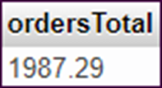
Get the total of the calculated values for all orders
SELECT SUM(itemPrice * quantity - discountAmount)
AS ordersTotal
FROM orderItems
The result set

Slide 39
The syntax of the GROUP BY and HAVING clauses
SELECT select_list
FROM table_source
[WHERE search_condition]
[GROUP BY group_by_list]
[HAVING search_condition]
[ORDER BY order_by_list]

Slide 40
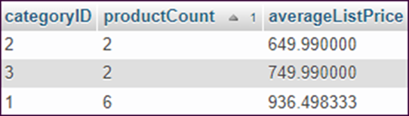
Calculate the average list price by category
SELECT categoryID, COUNT(*) AS productCount,
AVG(listPrice) AS averageListPrice
FROM products
GROUP BY categoryID
ORDER BY productCount
The result set

Slide 41
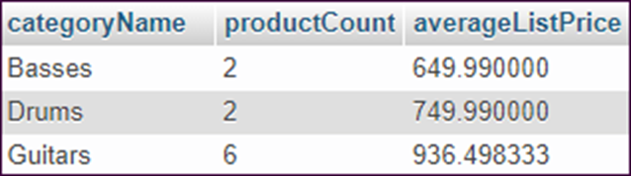
Use columns from multiple tables
SELECT categoryName, COUNT(*) AS productCount,
AVG(listPrice) AS averageListPrice
FROM products p JOIN categories c
ON p.categoryID = c.categoryID
GROUP BY categoryName
HAVING averageListPrice > 400
The result set

Slide 42
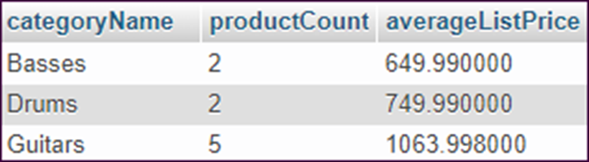
Use a WHERE clause to filter rows before grouping them
SELECT categoryName, COUNT(*) AS productCount,
AVG(listPrice) AS averageListPrice
FROM products p JOIN categories c
ON p.categoryID = c.categoryID
WHERE listPrice > 400
GROUP BY categoryName
The result set

Slide 43
Four ways to introduce a subquery in a SELECT statement
In a WHERE clause as a search condition
In a HAVING clause as a search condition
In the FROM clause as a table specification
In the SELECT clause as a column specification

Slide 44
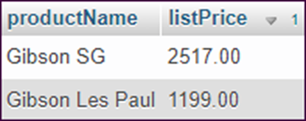
Use a subquery in the WHERE clause
SELECT productName, listPrice
FROM products
WHERE listPrice > (SELECT AVG(listPrice) FROM products)
ORDER BY listPrice DESC
The value returned by the subquery
841.895
The result set

Slide 45
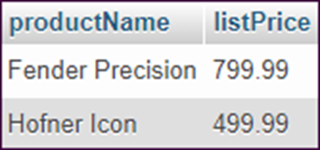
Use another subquery in the WHERE clause
SELECT productName, listPrice
FROM products
WHERE categoryID = (SELECT categoryID FROM categories
WHERE categoryName = 'Basses')
The result set

Slide 46
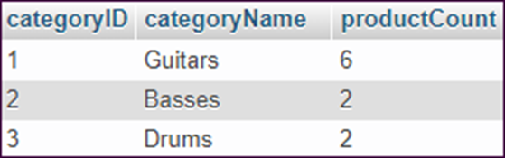
Use a correlated subquery in the SELECT clause
SELECT categoryID, categoryName,
(SELECT COUNT(*) FROM products
WHERE products.categoryID = categories.categoryID) AS productCount
FROM categories
The result set

Slide 47

The syntax of a subquery that uses the EXISTS operator
WHERE [NOT] EXISTS (subquery)
Get all customers that don’t have any orders
SELECT c.customerID, firstName, lastName
FROM customers c
WHERE NOT EXISTS
(SELECT * FROM orders o
WHERE c.customerID = o.customerID)
The result set

Slide 48
The syntax of the INSERT statement
INSERT INTO table_name [(column_list)]
VALUES (expression_1 [, expression_2]...)[,
(expression_1 [, expression_2]...)]...
The table definition
CREATE TABLE products (
productID INT NOT NULL
AUTO_INCREMENT,
categoryID INT NOT NULL,
productCode VARCHAR(10) NOT NULL,
productName VARCHAR(255) NOT NULL,
description TEXT NOT NULL,
listPrice DECIMAL(10,2) NOT NULL,
discountPercent DECIMAL(10,2) NOT NULL
DEFAULT 0.00,
dateAdded DATETIME NOT NULL
)

Slide 49
Add a single row without using a column list
INSERT INTO products
VALUES (DEFAULT, 1, 'tele', 'Fender Telecaster', 'NA',
'949.99', DEFAULT, NOW())
Add a single row using a column list
INSERT INTO products
(categoryID, productCode, productName, description,
listPrice, dateAdded)
VALUES
(1, 'tele', 'Fender Telecaster', 'NA',
'949.99', NOW())
Add multiple rows
INSERT INTO categories (categoryID, categoryName)
VALUES (4, 'Keyboards'),
(5, 'Brass'),
(6, 'Woodwind')

Slide 50
The syntax of the UPDATE statement
UPDATE table_name
SET column_name_1 = expression_1
[, column_name_2 = expression_2]...
[WHERE search_condition]
Update one column of one row
UPDATE products
SET discountPercent = '10.00'
WHERE productName = 'Fender Telecaster'
Update multiple columns of one row
UPDATE products
SET discountPercent = '25.00',
description =
'This guitar has great tone and smooth playability.'
WHERE productName = 'Fender Telecaster'

Slide 51
Update one column of multiple rows
UPDATE products
SET discountPercent = '15.00'
WHERE categoryID = 2
Update one column of all rows in the table
UPDATE products
SET discountPercent = '15.00'
Use a subquery to update multiple rows
UPDATE orders
SET shipAmount = 0
WHERE customerID IN
(SELECT customerID
FROM customers
WHERE lastName = 'Sherwood')
Warning
If you omit the WHERE clause, all rows in the table are updated.

Slide 52
The syntax of the DELETE statement
DELETE [FROM] table_name
[WHERE search_condition]
Delete one row
DELETE FROM products
WHERE productID = 6
Delete multiple rows
DELETE FROM products
WHERE categoryID = 3
Another way to delete multiple rows
DELETE FROM categories
WHERE categoryID > 3

Slide 53
Use a subquery to delete all order items for a customer
DELETE FROM orderItems
WHERE orderID IN
(SELECT orderID FROM orders
WHERE customerID = 1)
Warning
If you omit the WHERE clause, all rows in the table are deleted.

